Slide 1

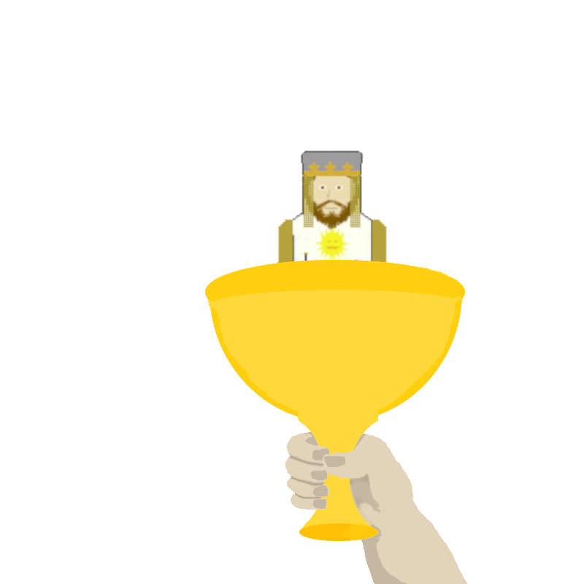
Monty Python and the Bridge of Death
A simple game?

Slide 2
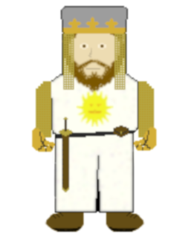
Main Parts
Main window – a simple start screen
False Loading Bar – A .gif animation that imitate a loading bar
Game window – A window with two portions;
Top half for images.
Bottom half for buttons the user clicks to give answers.

Slide 3
What does it do?
Nothing Really
It is like a quiz, looping until you choose the answers as given in the scene from the movie
Pays homage to the Guido van Rossum’s original inspiration for the languages name

Slide 4
Graphical User Interface
Tkinter, right?
Also Kivy, wxWidgets, FLTK, and many others
Each has their own commands
Some work well with other modules, some do not.

Slide 5
MPBOD
For MPBOD “tkinter” was used…
Animation
Multi-Windows
Image types; “.gif” and “.png”
Copyright concerns and Licensing Issues

Slide 6
